Slide 1

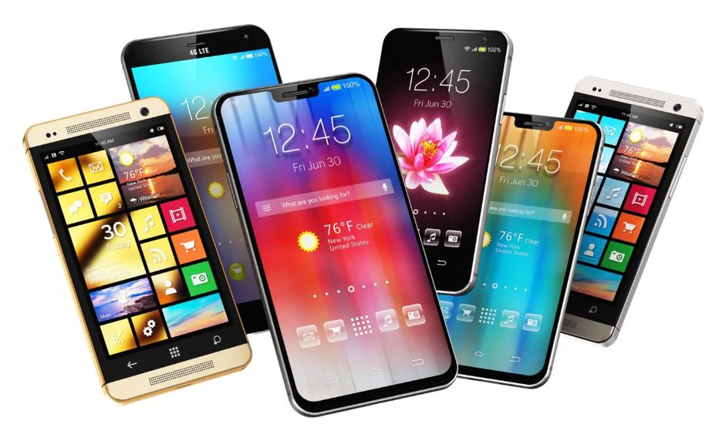
Mobile Price Prediction
Shubham Saxena
Affiliation :- DigiCrome

Slide 2
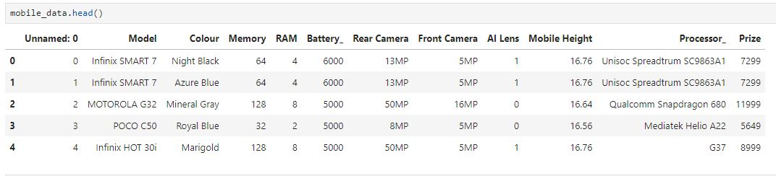
Project Overview :-
Mobile Price Prediction : Unveiling the Dynamics of Mobile Prices and features that affects it’s prices most
Here I have done data wrangling, finding any missing values(if present in the data set-Not Present in this data), detection of Outliers and it’s removal, along with correlation of the data with each-others, for better price of mobiles and it’s affecting factors.

Slide 3
Project Highlights :- Important libraries which are used :-
Pandas
Numpy.
Matplotlib
seaborn
Warnings
sklearn
import pandas as pd
import numpy as np
import matplotlib.pyplot as plt
import seaborn as sns
Import warnings (to ignore unwanted warnings)
import train_test_splitfrom
import OneHotEncoder, StandardScalerfrom
import LinearRegressionfrom
import mean_absolute_error, mean_squared_error, r2_scorefrom
import RandomForestRegressor

Slide 4
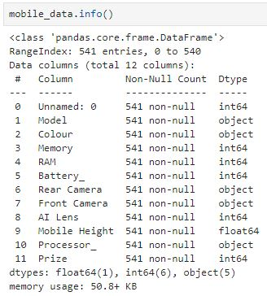
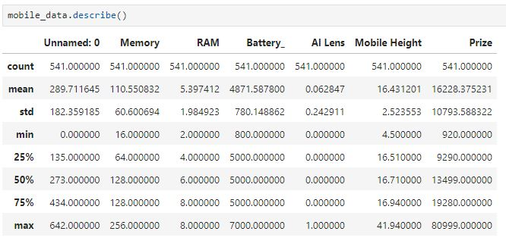
Problem Statement :- here we are doing some functions to understand Mobile_data

Slide 5
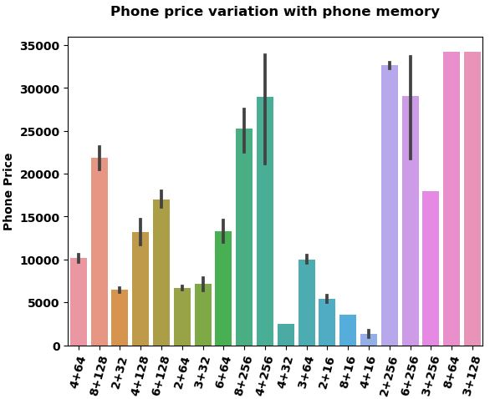
Barplots of different correlation of data :-

Slide 6
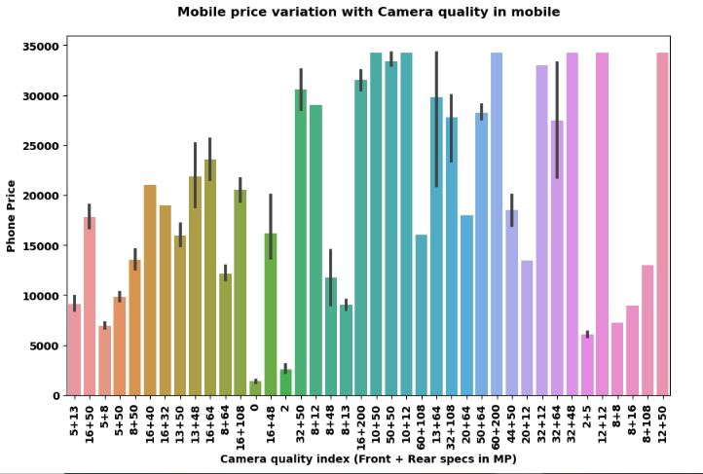
Barplots of different correlation of data :-

Slide 7
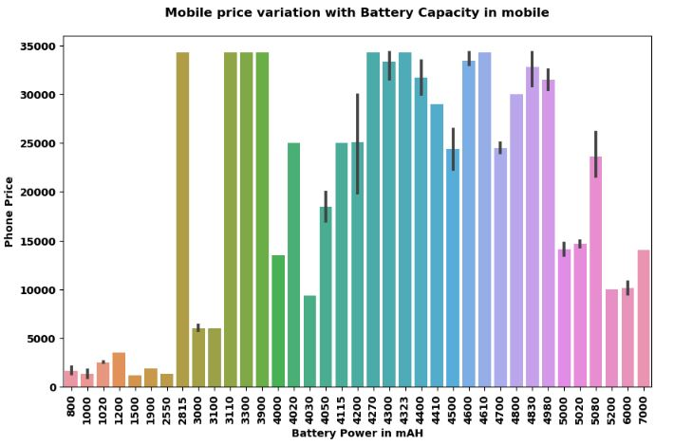
Barplots of different correlation of data :-

Slide 8
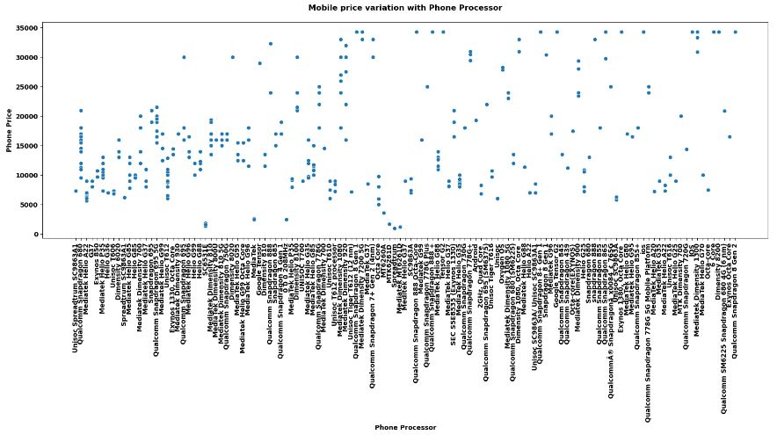
Scatterplot of Mobile’s Price correlation with Mobile’s Processor :-

Slide 9
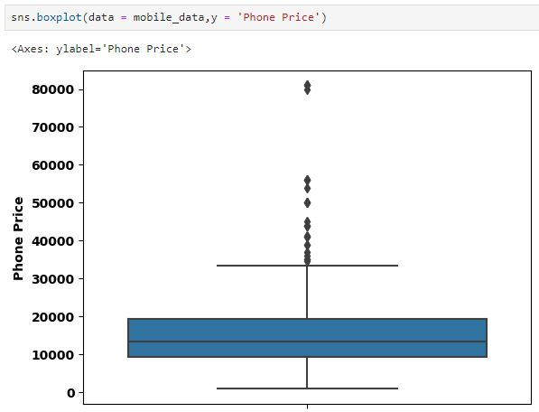
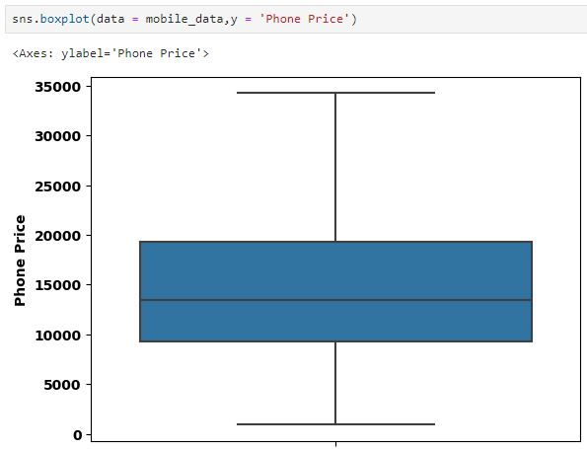
Methodology :- Used related modules to identify Outliers in final data and removed it.

Slide 10
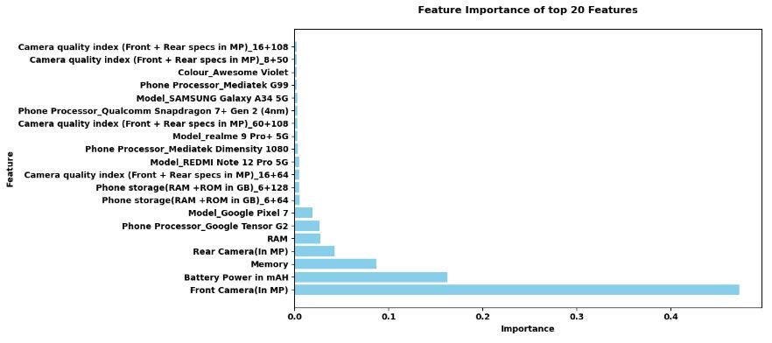
Feature Importance :- Top 20 features which affects the Price of Mobile

Slide 11
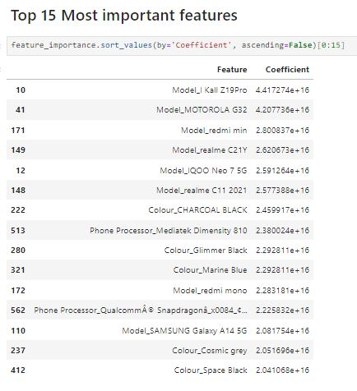
Feature Importance :- Top 15 features which affects the Price of Mobile

Slide 12
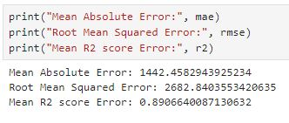
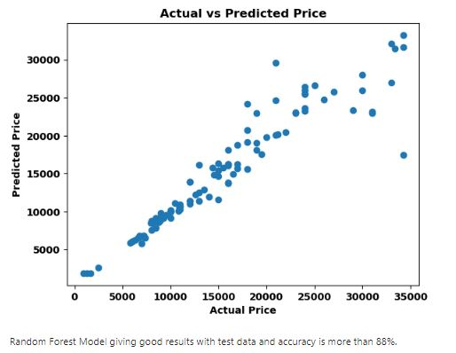
Glimpse of Final data :- Error’s and accuracy of Final data.

Slide 13
Conclusion :- The prices of Mobiles are higher for:
General Trend: When memory capacity increases, mobile phone prices also increases. Exceptions: However, there are exceptions. Some phones with relatively lower memory capacities may have higher prices because of other factors such as mobile brand, camera quality, any other unique features.
Camera Quality
Positive Correlation: When the camera quality increases, the price of the mobile phone also increases. This suggests that consumers are willing to pay more for better camera specifications.
Variability: While there is a positive trend, there is also significant variability in prices for phones with similar camera quality. Factors such as brand reputation, additional features, and market demand for any particular phone, contribute to this variability.
Battery Capacity (mAh).
Data shows the pattern that higher battery capacity does not necessarily correlate with a higher price. In some phones with lower battery capacities are priced higher than those with larger batteries.
Processors :- When Processor quality is increased, the price of the mobile phone also increases.
No any direct relation of Mobile Phone’s Prices with Colors, Heights of the Phone

Slide 14


